Slide 1
6G4Z0024 Web Development Lecture 8: RESTful APIs
Yanlong Zhang
Y.Zhang@mmu.ac.uk

Slide 2
Learning Objectives
To understand key concepts of RESTful APIs and how RESTful APIs work.
Be familiar with RESTful APIs tool, Postman

Slide 3
Last week recap
Expanding on our JS skillset
Looking at form validation with Regular Expressions

Slide 4
Questions?

Slide 5
Recap: what is a client-server architecture?

Slide 6
Recap: what is HTTP?

Slide 7
What is a API?

Slide 8
What is an API?
Application Programming Interface
Allows different software systems to interact with each other
Defines how communication is exchanged between the different systems

Slide 9

What is a REST API?
(Roy Fielding, 2000)

Slide 10
What is a RESTful API?
Representational State Transfer
Client makes a call to a server, and receives data back – just like with the web…
REST APIs use HTTP methods for requests
Typically use JSON or XML for sending data

Slide 11
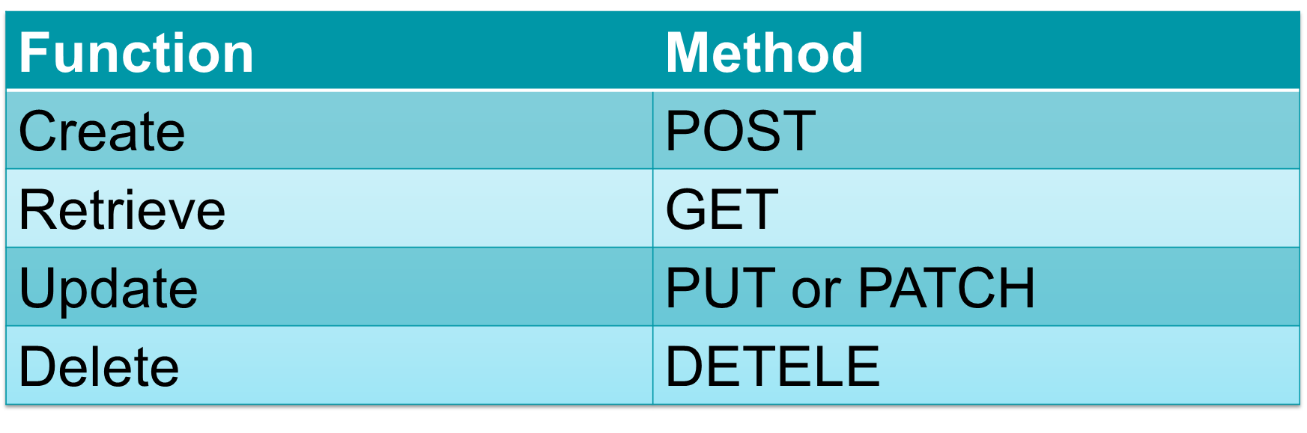
CRUD Functionality
Four functions that are considered necessary to implement a persistent storage application
We can now create and retrieve. There are also methods for updating and deleting.

Slide 12
A closer look at HTTP
When we request a page from the web through the browser, we are pulling the information from a server somewhere on the internet
A DNS service will translate the readable URL to some IP address. The request is routed through the internet to the server for processing
This is called a GET request.

Slide 13
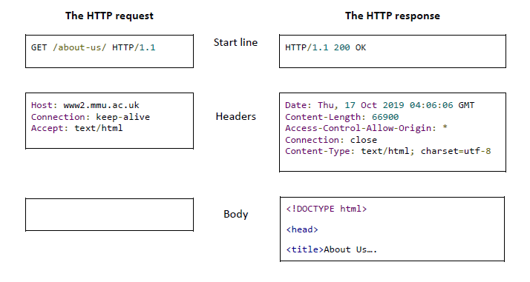
GET Request

Slide 14
Response Codes
The server sends a response code and any required data that has been requested.
Some codes that you may be familiar with:
200 Successful
404 Not Found
400 Bad Request
500 Server Error

Slide 15
Response Codes
Some codes that you may not be familiar with:
201 Created
401 Unauthorized
403 Forbidden

Slide 16
Response Codes
1xx Informational response - the request was received, continuing process
2xx Successful - the request was successfully received, understood, and accepted
3xx Redirection - further action needs to be taken in order to complete the request
4xx Client error - the request contains bad syntax or cannot be fulfilled
5xx Server error - the server failed to fulfil an apparently valid request

Slide 17
Response Codes
A list of all response codes is maintained on Wikipedia:
https://en.wikipedia.org/wiki/List_of_HTTP_status_codes
There are some strange ones, such as ‘418 I’m a teapot’ which was originally an April fool's joke.

Slide 18
POST Request
As well as GET-ting information, we sometimes want to send data
Submitting a contact us form
Logging in
Posting a status
We can do this using a POST request…

Slide 19
POST Request
POST /user HTTP/1.1
HTTP/1.1 201 Created
Host: localhost:8080
Content-Type: application/json
{ name: “Yanlong Zhang” }

Slide 20
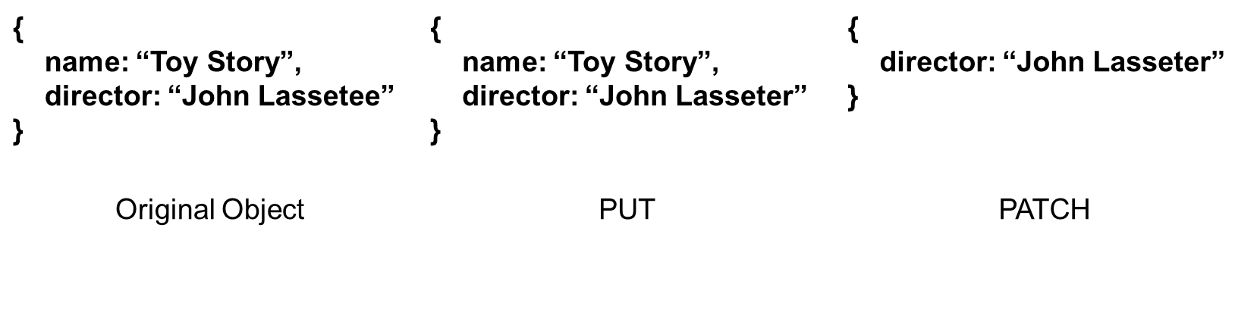
Updating
PATCH or PUT
PUT will replace the entire existing object with a new object
PATCH will update just the relevant fields

Slide 21
Delete
DELETE http://localhost:8080/user/1232456
Security has to be tight here – you don’t want to delete the wrong thing
Often some sort of verification procedure on the front end, and then resource will be achieved rather than a hard delete.

Slide 22
Worked Example
So how does this work in the real world?

Slide 23
Lab exercise
Consider a movie database. We want users to be able to:
Retrieve a list of all movies
Retrieve the details of a single movie
Add a new movie to the database
Update an existing movies details
Delete a movie from the database

Slide 24
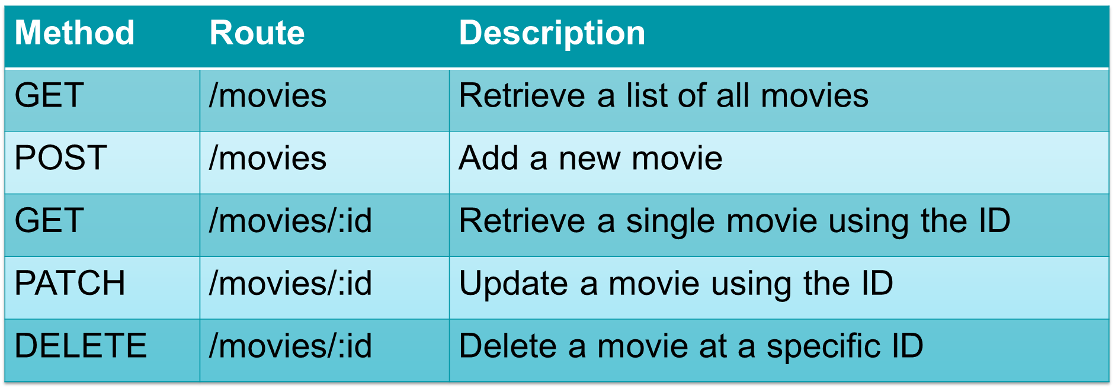
Worked Example

Slide 25
Parameters
Path Parameters
Note that some routes require the use of path parameters to identify specific resources
Query Parameters – are also a thing…
Another way of sending information to the server
Perhaps most used for filtering information that you are GET-ting.
E.g. http://google.com/search?q=hello

Slide 26
Headers
Used for sending additional information and meta-data
E.g. Content-Type: application/json (or image/jpeg, or image/png)
https://en.wikipedia.org/wiki/List_of_HTTP_header_fields

Slide 27
Security
Obviously API security is a huge deal – open interface to the world
An in depth look at security is out of the scope of this unit, but two methods are:
Limiting the methods, parameters, headers that are allowed into the system and give a default error if not allowed
E.g. 405 Method Not Allowed
Authorization tokens (API has to be stateless by definition)

Slide 28
Tools: Postman
An application for sending and receiving HTTP requests
Can test APIs and use Postman to ensure your understanding is correct before coding

Slide 29
Demo: Testing MovieDB with Postman

Slide 30
This week's lab
Understand RESTful APIs better
Practice interacting with REST APIs with postman
Make progress on your assignment

Slide 31
Questions?

